Slide 1
Competitive Assessment of Scala vs. PySpark
Max Moro
Nikhil Gupta

Slide 2
Distributed Computing
The Need
As the size of data increases, it needs to be stored and computed over distributed systems
The Solution
MapReduce and Hadoop
Uses a network of many computers for massive amounts of data and computation
The Evolution
Spark (Apache)
Faster, Distributed, in Memory

Slide 3
Spark
Quickly and easily handle Big Data
Latest Technology
Works also with AWS, Cassandra, and more
Flexible Alternative to MapReduce
Keeps data in memory (vs. hard disk for MapReduce)
Distributed data collection
100x faster then MapReduce

Slide 4
Scala
General purpose programming Language
Overcome Java’s shortcomings
Used for
No boilerplates
Web App
Data Streaming
Parallel Processing
Analysis using Spark
Easy to code
From Object-Oriented to Functional Programming
Java VM

Slide 5
PySpark
What?
Why?
Spark API’s for Python programming language
Python is the most popular language for machine learning
Allows easier interfacing to existing applications built in Python

Slide 6
Project Goal 1
Scala
Python (PySpark)
Which one is Faster?
Notes:
We would like to keep it open if we find other options to compare

Slide 7
Project Goal 2
Should a company invest in a new environment like Scala?
Leveraging the ML capabilities and flexibility of Python
Embracing Scala’s Speed and Features?
Both?

Slide 8
Design of Experiment
Random Data Generator in Python
Data Generation
Executed in Random order in each run.
Query Execution
By Machine
By Setup
By Data Size
By Operation
Blocking

Slide 9
Design Metrics
Avoid Human Error
Automated Timing Code
Logging Capability
Query Execution Time
Does performance change with data size?
Execution Time normalized for data size
MB processed / second
Throughput

Slide 10
Datasets - Rows
10MBs
100MBytes
200MBytes
10K rows
100K rows
200K rows
300MBytes
500MBytes
300k rows
500k rows

Slide 11
Datasets - Columns
Integers
20 Columns
Characters
Floating Point
Random positive and negative numbers
20 columns
Random positive and negative numbers
From 5 to 10 words per sentence
Randomly Generated from a 400k word dictionary
Groups
2 to 3 word identifiers (factors) used for grouping
10 columns
10 columns
From 1k to 50k groups per dataset
Randomly Generated from a 400k word dictionary

Slide 12
Queries
Row Operations
Filtering
Running Sum
Column Operations
Inner Join
Outer Join
Merge
Mixed
Pivot
Writing
Aggregate Operations
Regular Expression
Lagging
Sort
Full Join
Calculation
Split
Group By
Ranking
6 runs per each Dataset

Slide 13
Environments
Local Machine
AWS – EC2
AWS - MapReduce
2 Local Virtual Machines
2 AWS Virtual Machines
Virtual Cluster Setup
Using Databricks
1 master and 3 slaves
Using Databricks

Slide 14
Data Points
5 Datasets
33 Queries
3* Environments
6 Runs
2 Languages
2 Machines
9,900 Data Points
We completed a total of 300 tests, with 33 queries each, obtaining 9,900 data points used to complete the analysis.
* Cluster environment analysis was performed on only 1 machine

Slide 15
Statistical Analysis
Warm Cache Runs
Discard first run
Memory Flush
Right Skewed Data
Unequal Variance
Wilcoxon Rank Sum Test
Statistical Analysis

Slide 16
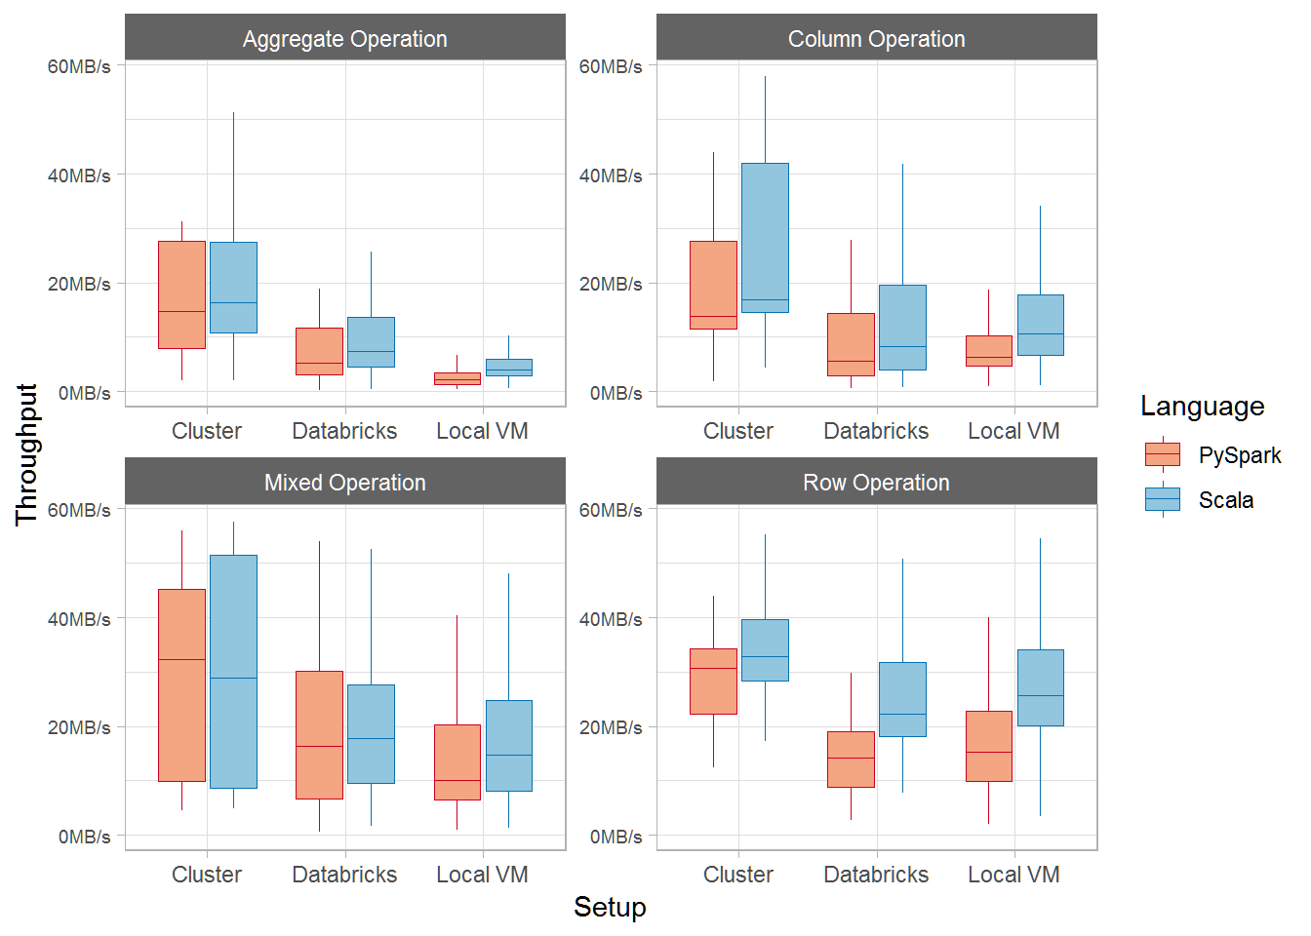
Results – Environments

Slide 17
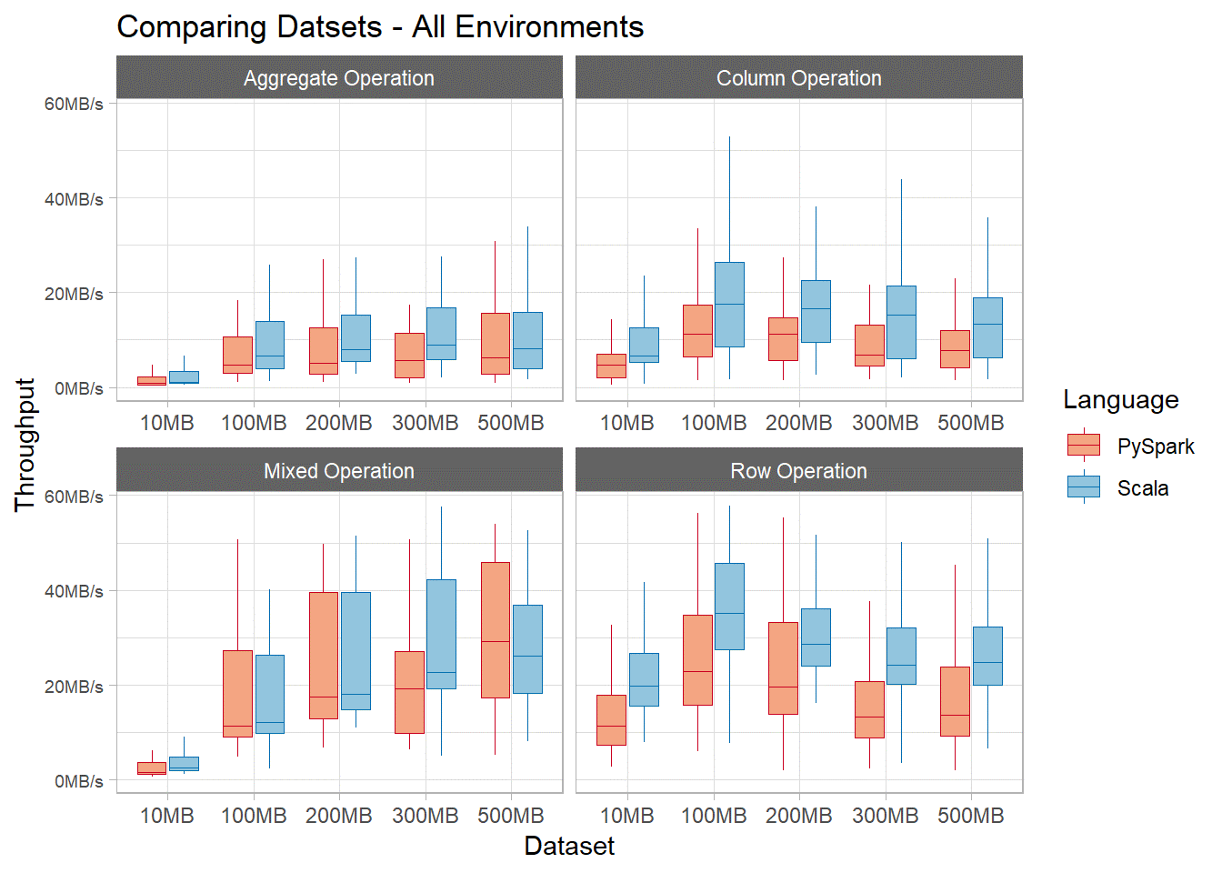
Results – Datasets

Slide 18
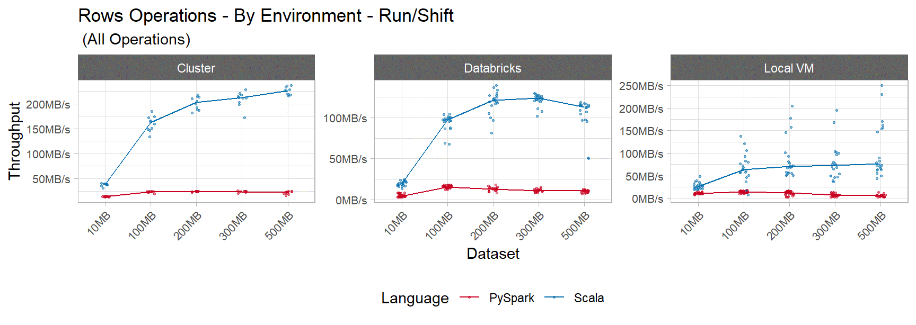
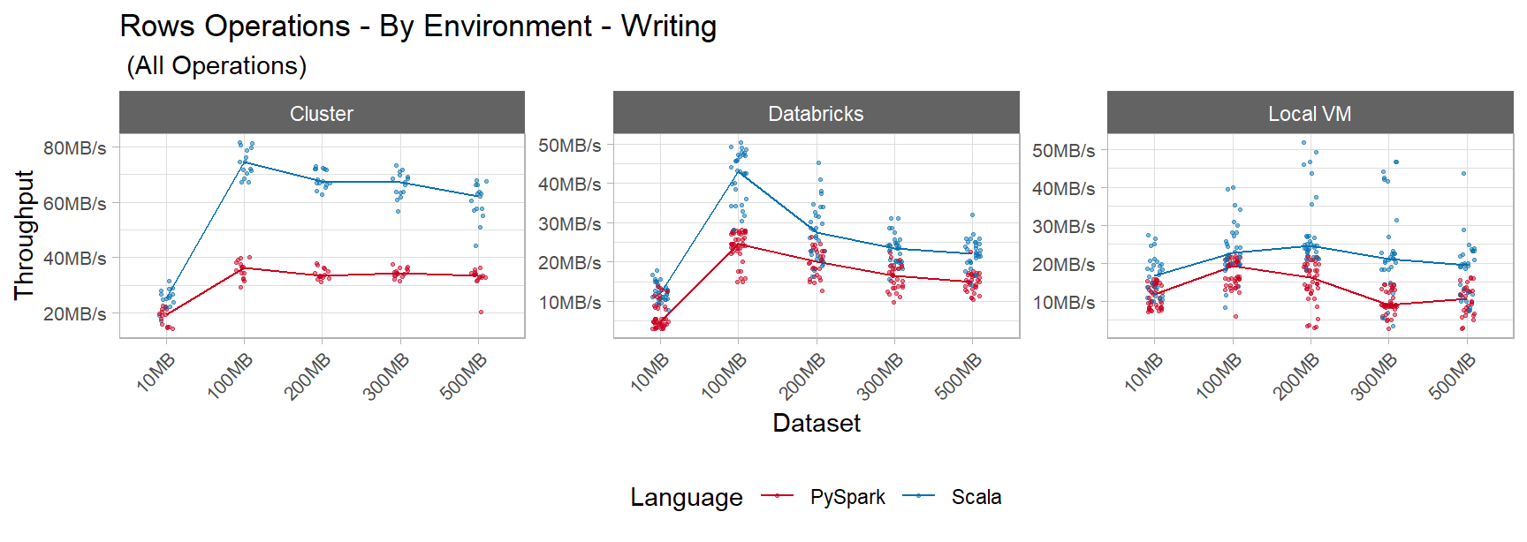
Results – Row Operations

Slide 19
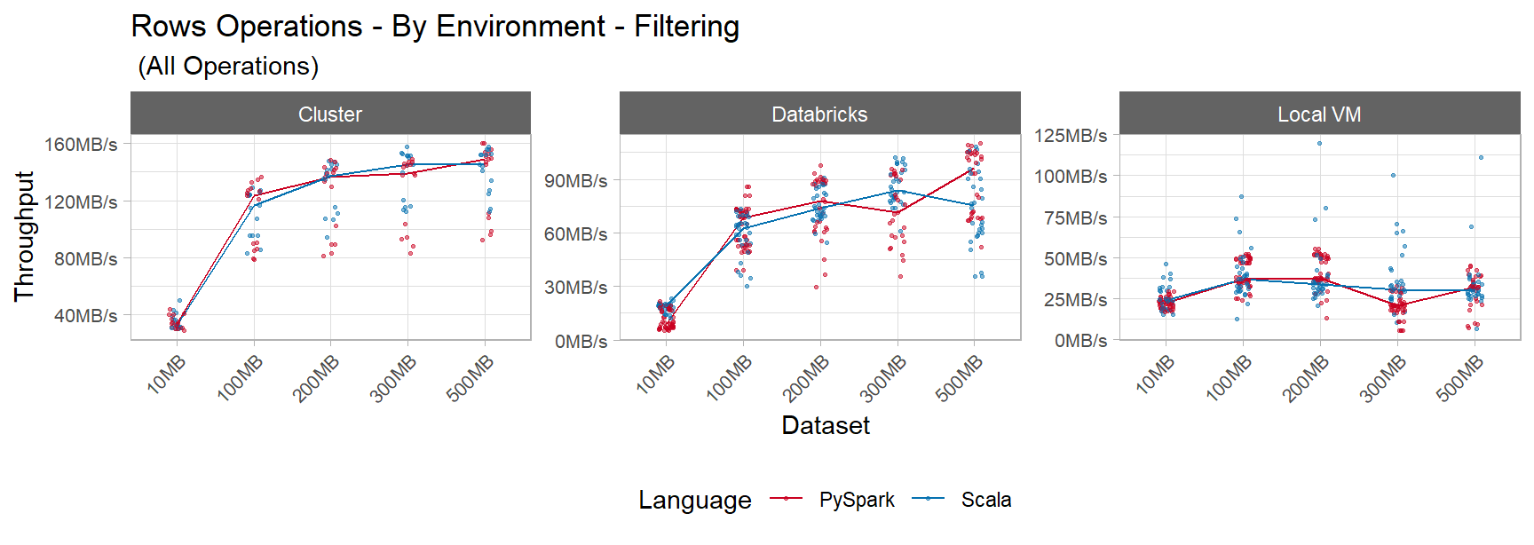
Results – Row Operations

Slide 20
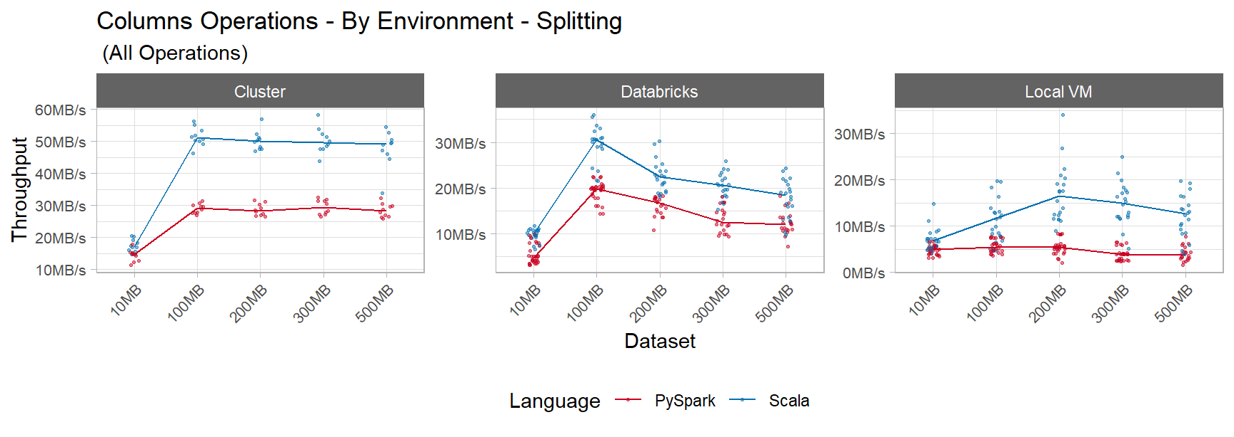
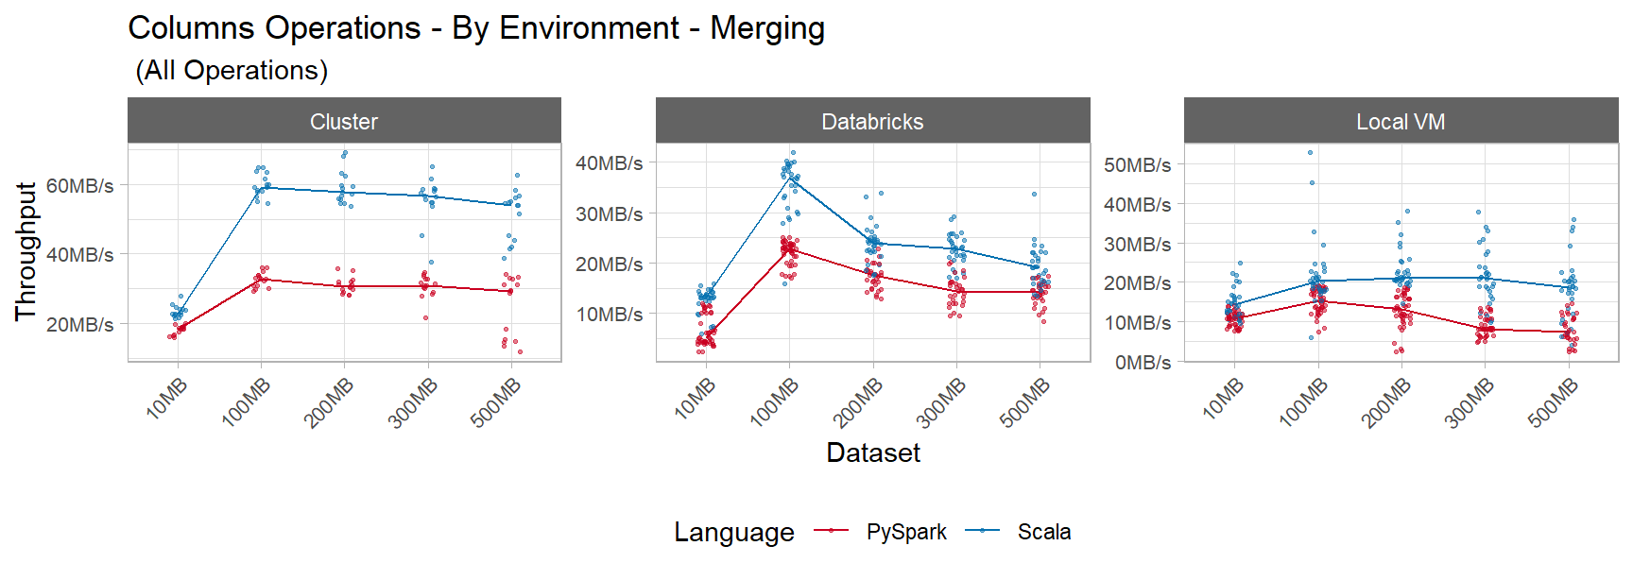
Results – Column Operations

Slide 21
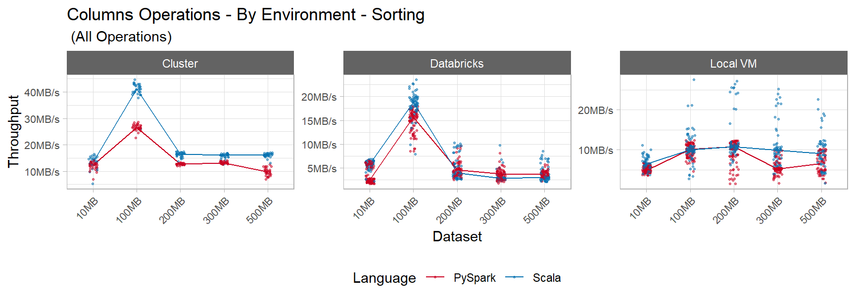
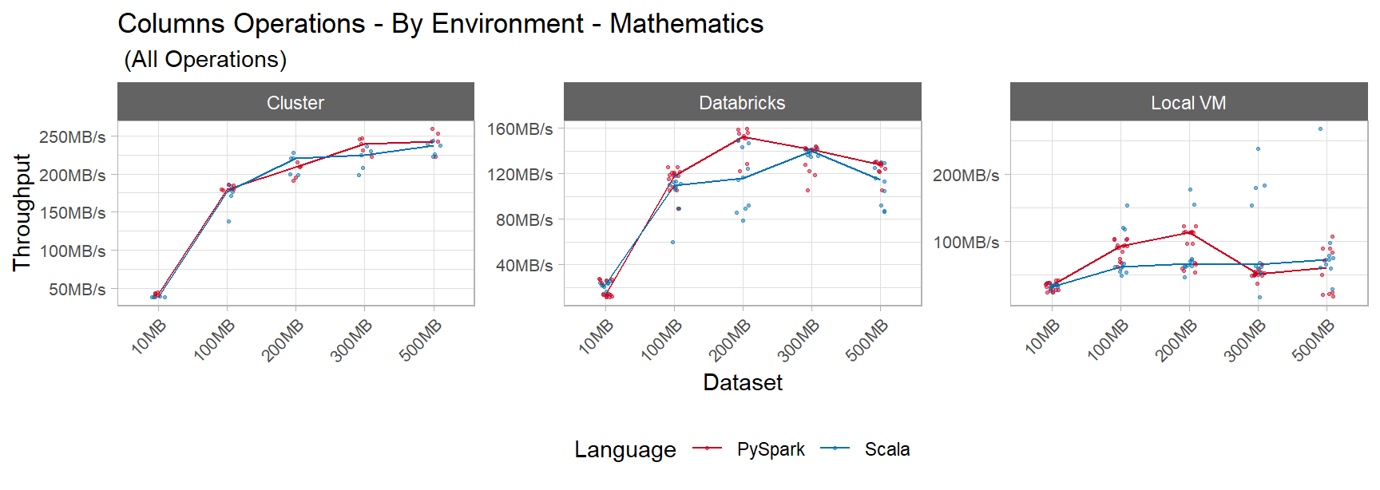
Results – Column Operations

Slide 22
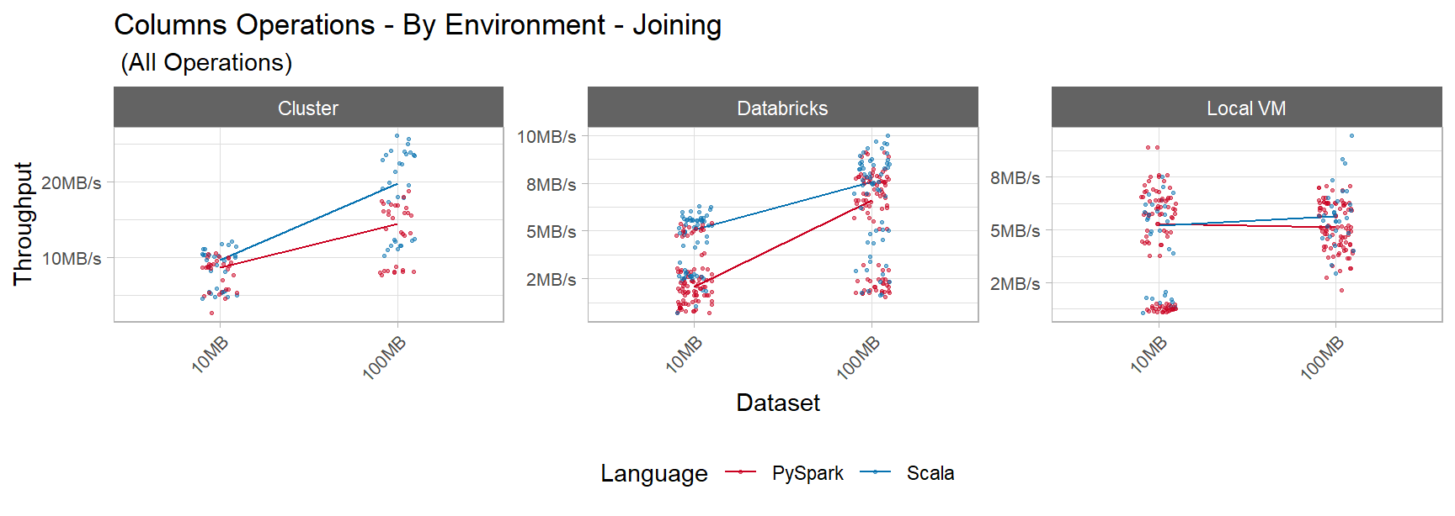
Results – Column Operations

Slide 23
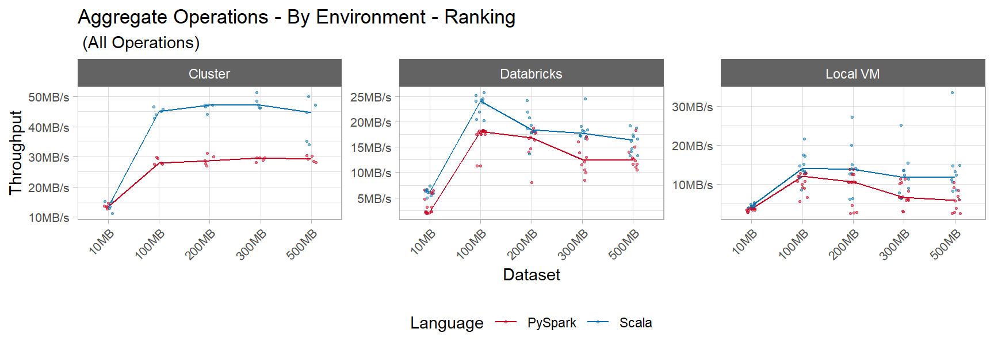
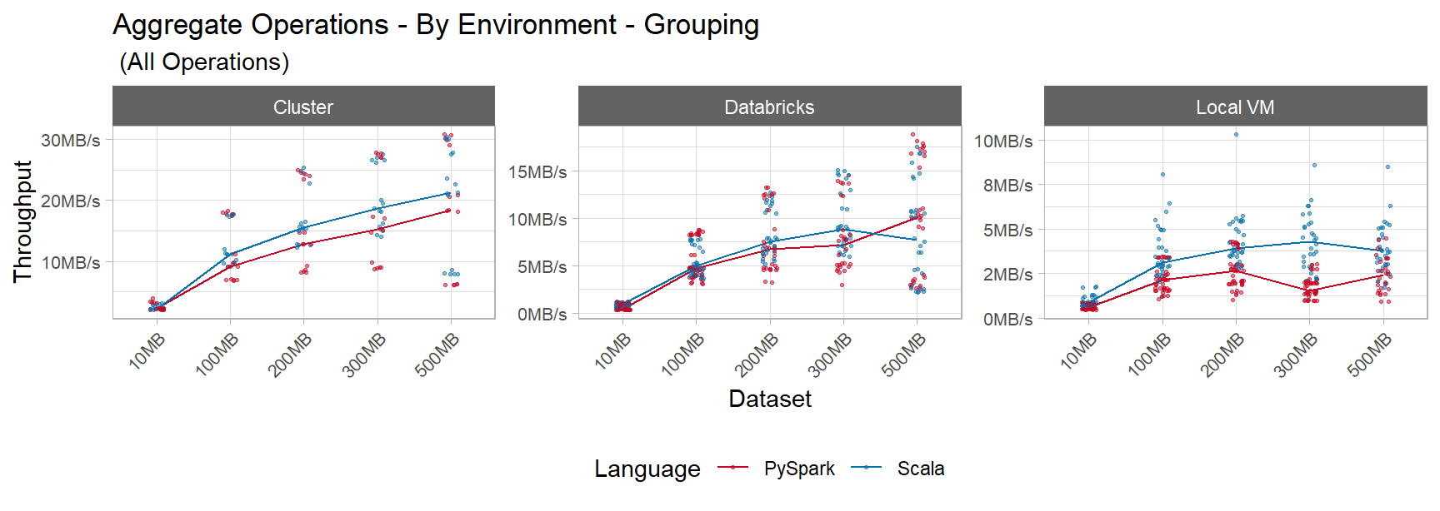
Results – Aggregate Operations

Slide 24
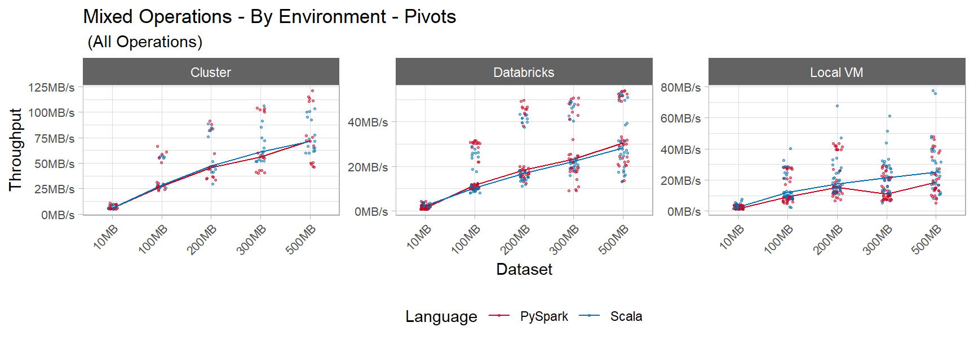
Results – Mixed Operations

Slide 25



Result Summary
Row Operations
Filtering
Running Sum
Column Operations
Join
Writing
Aggregate and Mixed Operations
Lagging
Calculation
Group By
Ranking
Scala Faster
Scala Faster
Scala Faster
Tie
Split & Merge
Scala Faster
Sort
Scala Faster
Scala slightly faster
Tie
Scala slightly faster
Scala faster
Pivot
Tie

Slide 26
Key Findings
Setup
AWS has some complexity to setup Spark and libraries
Databricks makes the process much easier
Memory
Spark uses a lot of memory
A 500MB dataset requires 8GB of memory to run complex queries
Scala
Similar to Java
Fast but some limitations on libraries
Many functions are still in beta
Complex to setup in Linux
PySpark
Scala-like commands + flexibility of Python
API data transfer has a performance penalty

Slide 27
Conclusion
For Data Scientists, what is the best Big Data Solution?
Which one is faster?
Scala is faster (compared to PySpark) for most operations
Is it worth learning a new faster language?
Difference in performance increases as machines become more powerful (e.g. on distributed cluster)
Scala is not yet mature as Python
Use Scala for larger datasets if ML algorithms are available
Use PySpark for data manipulation + Python if ML algorithms not available in Scala.

Slide 28
Reproducible Research
Code for queries and complete analysis is available on GitHub

